Slide 1
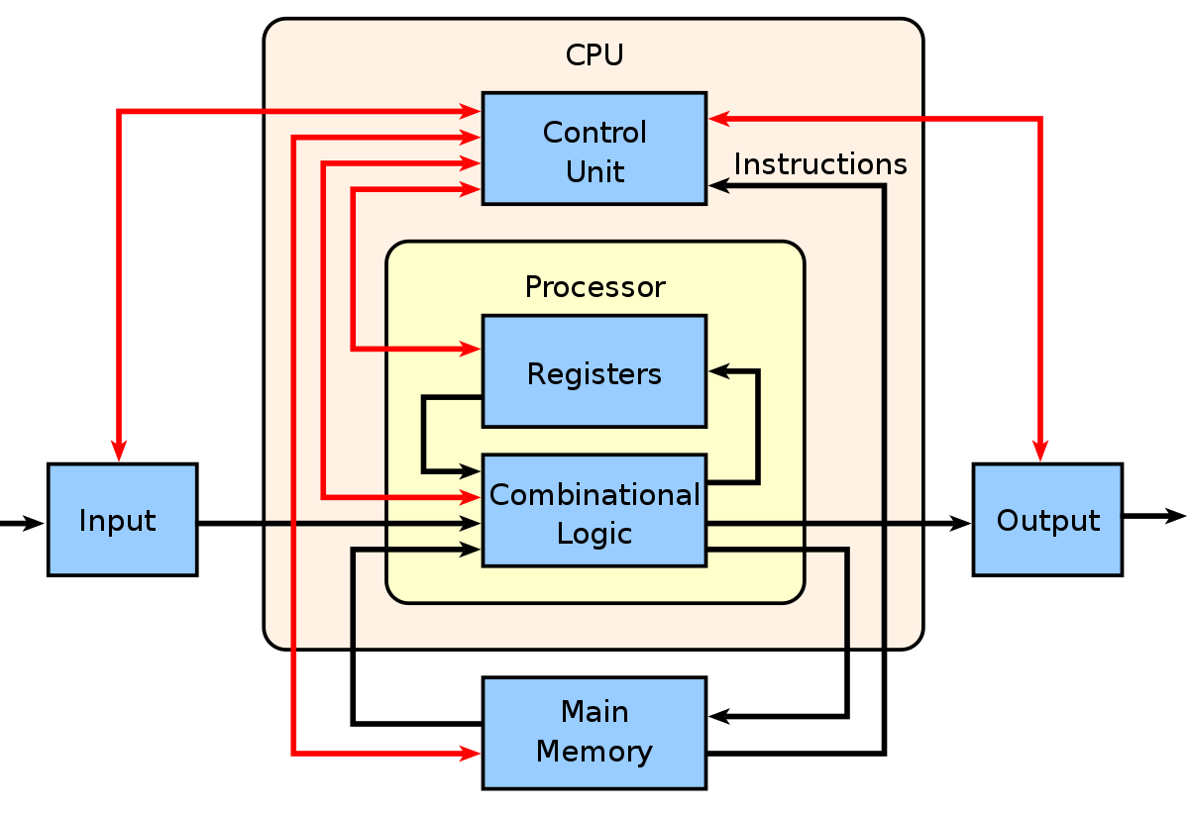

Slide 2
Register organsiation
https://www.slideshare.net/AsifIqbal109/register-organization-stack
https://www.geeksforgeeks.org/general-purpose-registers/
https://slideplayer.com/slide/14526588/

Slide 3
Instruction format
https://slideplayer.com/slide/14526588/
https://www.includehelp.com/embedded-system/instruction-format-in-8086-microprocessor.aspx
https://slideplayer.com/slide/15066248/

Slide 4
Instruction cycle
https://slideplayer.com/slide/15651514/

Slide 5
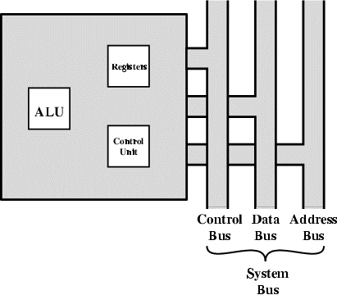
Processor organization
Things a CPU must do:
Fetch Instructions
Interpret Instructions
Fetch Data
Process Data
Write Data

Slide 6
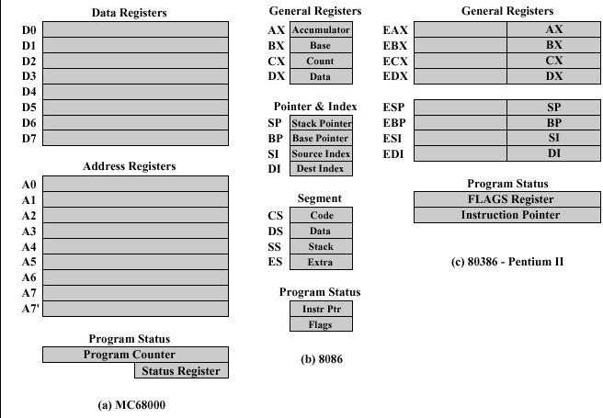
Microprocessor register organization

Slide 7
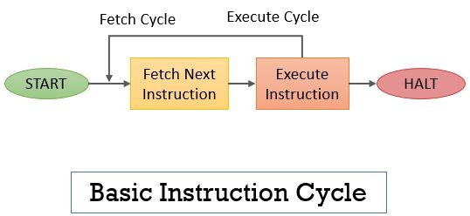
Basic instruction cycle
The instruction cycle defines the processing or execution of a single instruction.
It consist of two main steps:
Fetch cycle to fetch the operation
Execute cycle to execute operation.

Slide 8
Basic instruction cycle
To start the execution of a program, the processor runs the fetch cycle and fetches the first instruction from the memory. Program counter (PC) holds address of the instruction to be fetched next.
The execution cycle interprets the operation and performs the operations specified in the instruction accordingly.
This cycle repeats until all the instructions are executed from the program and after the execution of the last instruction the instruction cycle get halt. So, this was the scenario where there were no interrupts.

Slide 9
Interrupt
Interrupt is the method of creating a temporary halt during program execution and allows peripheral devices to access the microprocessor.
The microprocessor responds to that interrupt with an ISR (Interrupt Service Routine), which is a short program to instruct the microprocessor on how to handle the interrupt.

Slide 10
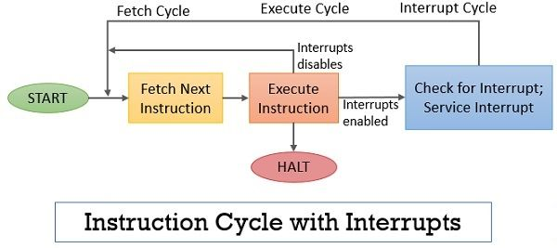
Instruction cycle with interrupt
Instruction cycle contains the following sub-cycles.
Fetch - read next instruction from memory into CPU
Execute - Interpret the opcode and perform the indicated operation
Interrupt - if interrupts are enabled and one has occurred, save the current process state and service the interrupt

Slide 11
Instruction and Instruction sequencing
A computer program consist of a sequence of small steps.
A computer must have instructions capable of performing four types of operations:
Data transfers between the memory and the processor registers
Arithmetic and logic operations on data
Program sequencing and control
I/O transfers

Slide 12
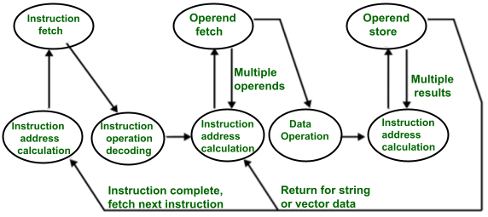
Instruction cycle state diagram

Slide 13
Instruction cycle state diagram
The processor has a register named program counter which has the address of the instruction that has to be executed next. It gives the address of the instruction which needs to be fetched from the memory.
If the instruction is fetched then, the instruction opcode is decoded. On decoding, the processor identifies the number of operands.
If there is any operand to be fetched from the memory, then that operand address is calculated.
Notes:
https://binaryterms.com/hardwired-control-unit.html

Slide 14
Instruction cycle state diagram
Operands are fetched from the memory. If there is more than one operand, then the operand fetching process may be repeated (i.e. address calculation and fetching operands).
After this, the data operation is performed on the operands, and a result is generated.
If the result has to be stored in a register, the instructions end here.
Side by side, the PC is incremented to calculate the address of the next instruction.
Above instruction cycle is repeats for further instructions.

Slide 15
Design of control unit
The Control Unit is classified into two major categories:
Hardwired Control
Microprogrammed Control

Slide 16
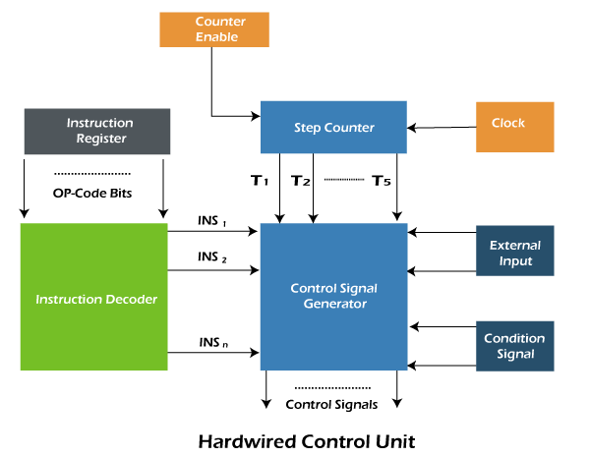
Hardwired Control
A hardwired control is a method of generating control signals with the help of sequential logic circuit or Finite State Machines. It is designed with the help of gates, flip-flops, decoders, and other digital circuits.

Slide 17
Hardwired Control
Instruction Register: The instruction fetched from the main memory is placed in the instruction register and the instruction remains there till its execution is completed.
Instruction Decoder: The instruction decoder interprets the opcode and the addressing mode from the instruction register and determines what actions have to be taken.
Step Counter: The step counter is used to track the progress in the execution of the instruction. The step counter indicates which step among the five i.e. instruction fetch, decode, operand fetch, execute, operand store steps is being carried out.

Slide 18
Hardwired Control
Control Signal Generator: It is a combinational circuit that generates the control signals depending upon their input.
Clock: The clock implement in the control circuitry is such that it completes one clock cycle for each step of instruction execution.
External Inputs: The external input component acknowledges the control circuitry about the external signal such as interrupts.
Conditional Signals: These components help the control unit in generating the control signals for branching instructions.

Slide 19
Hardwired Control
Initially, the instruction to be executed is fetched from the main memory and is a place in the instruction register which in turn generates the opcode which is interpreted by the instruction decoder. After interpreting the opcode bits the instruction decoder activates the corresponding INSi signal to the control circuitry.
With each clock cycle, one of the timing signals from T1 to T5 is activated indicating which step is from instruction fetch to operand store is being carried out. Based on the timing signals from the step counter and signals from the instruction decoder the control unit generates the control signals. The control signals are even influenced by the external signal and the conditional signals.

Slide 20
Hardwired Control
Factors Considered for the design of the hardwired control unit.
Amount of hardware - Minimise the number of hardware used.
Speed of operation - If a single IC can replace a group of IC, replace it. The amount of hardware and speed of operation are inversely proportional to each other.
Cost

Slide 21
Hardwired Control
Advantages:
Extremely fast
Instruction set size is small as it relies on hardware more.
The rapid mode of operation can be produced by optimising it.
Disadvantages:
Modification becomes tougher as each time we have to play with complex circuits.
Difficult to handle complex instructions.
Design is complicated, and decoding is complex.

Slide 22
2. Microprogrammed Control
As the name suggests, these control units are designed with the help of a micro-program. This micro-program is a collections of micro-instructions stored in the control memory.
A micro-instruction consist of one or more micro-operations to be executed and the address of the next micro-instruction.
Example of micro-instruction:
MAR←R3
In the above instruction, we are fetching the operand.
The control signal for the above example:
MARᵢₙ , R3ₒᵤₜ

Slide 23
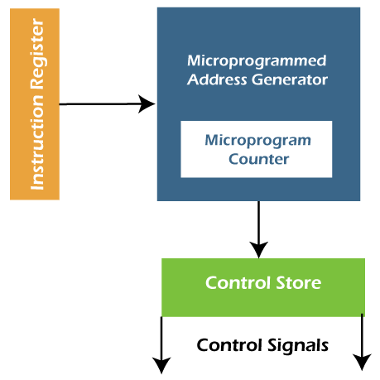
2. Microprogrammed Control unit
In this, the micro-operations are performed by executing a program consisting of micro-instructions.
The implementation of this CU is very easy and flexible, but it is slower as compared to the Hardwired control unit.

Slide 24
2. Microprogrammed Control
Instruction fetch is the first step. In this step, the instruction is fetched from the IR with the help of a Microinstruction address register.
Decode is the second step. In this step, the instructions obtained from the instruction register will be decoded with the help of a microinstruction address generator.
Increment is the third step. In this step, the control word, which corresponds to the starting address of a micro-program, will be read. When the execution proceeds, the micro-program counter will be increased so that it can read the successive control words of a micro-routine.

Slide 25
2. Microprogrammed Control
4. End bit is the fourth step. In this step, the microinstruction of a micro-routine contains a bit, which is known as the end bit. The execution of the microinstruction will be successfully completed when the end bit is set to 1.
5. In last step, the micro-program address generator will again go back to Step 1 so that we can fetch a new instruction, and this process or cycle goes on.
So in the micro-programmed control unit, the micro-programs are stored with the help of Control memory or Control store.

Slide 26
Concept of Nano programming
In most microprogrammed processors, an instruction fetched from memory is interpreted by a micro program stored in a single control memory (CM).
In some microprogrammed processors, the micro instructions are not directly used by the decoder to generate control signals. They use second control memory called a nano control memory (nCM).

Slide 27
Concept of Nano programming
So they are two levels of control memories,
A higher level control memories is known as micro control memory (μCM)
A lower level control memories is known as nano control memory (nCM).
The μCM stores micro instructions whereas nCM stores nano instructions.

Slide 28
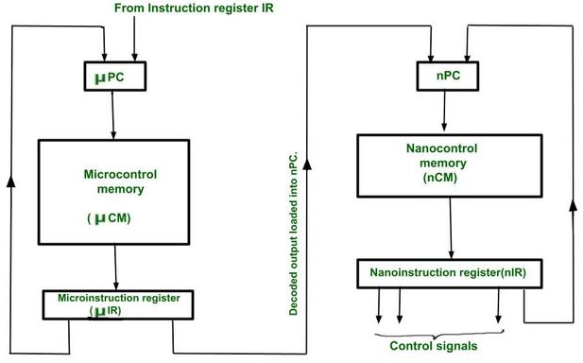
Concept of Nano programming

Slide 29
Concept of Nano programming
The instruction is fetched from the main memory into instruction register IR.
Using its opcode we load address of its first micro-instruction into µPC,
Using this address we fetch the micro-instruction from micro control memory (µCM) into micro instruction register µIR.
This is in vertical form and decoded by a decoder.
The decoded output loads a new address in a nano program counter (nPC).

Slide 30
Concept of Nano programming
By using this address, the nano-instruction is fetched from nano-control memory (nCM) into nano instruction register (nIR).
This is in horizontal form and can directly generate control signals which can be multiple at a time.
Such a combination gives advantage of both techniques.
The size of the control Memory is small as micro-instructions are vertical.

Slide 31
Nano programming
Advantages:
Reduces total size of required control memory
Disadvantage:
The main disadvantage of the two level memory approaches is the loss of speed due to the extra memory access required for nano control memory.

Slide 32
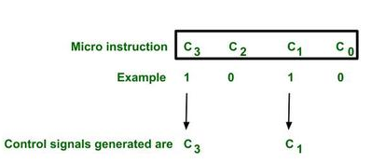
Micro instruction format
Type-1 :
Horizontal micro-instruction :

Slide 33
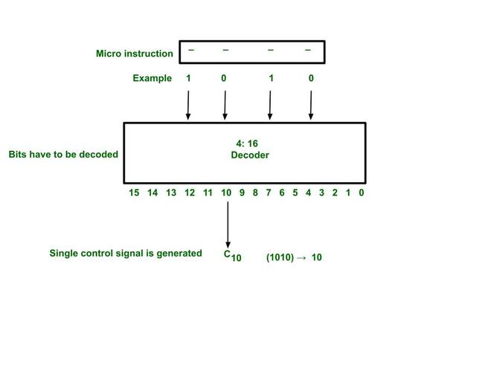
Micro instruction format
Type-2 : Vertical micro-instruction

Slide 34
Flynn’s Classification
https://slideplayer.com/slide/5898321/

Slide 35
Pipelining
https://www.javatpoint.com/instruction-pipeline

Slide 36
hazards
https://www.cs.umd.edu/~meesh/411/CA-online/chapter/pipeline-hazards/index.html

